Slide 1
OCR Data Analyst Interview
Adam Erler

Slide 2
Methodology
The entire analysis was created using Python. This ensures each step along the path is repeatable and transparent.
Git repository
Data as Code
Notes:
https://github.com/aerler101-1/OCR-Dashboard/tree/main, talk about version control and purpose of git, tools used python, streamlit for dashboard, jupyter notebook for transparency

Slide 3
Process
1: Exploratory Data Analysis (EDA)
2: Initial Findings
3: Attention Areas
4: Next Steps
Notes:
Focused on a small bandwidth for a deeper dive

Slide 4
Process: EDA
Python Scripts for the EDA
Redact PII
Names for employees were removed using Python. All further analysis is conducted using this redacted data set.
Mil Status
The enumerations for Mil status are not the same in applicant and employee data.

Slide 5
Process: EDA
Python Scripts for the EDA
Compared Structure
Common Columns: 'Disabled', 'Mil Status', 'Position Number', 'Sex', 'Race/Ethnicity', 'Disab Vet'
Unique Employee Columns: 'Employee ID', 'Name', 'Position Category', 'Start Date', 'Translate', 'Res Cntry', 'Annual Salary', 'Birthdate', 'EEO-6 Cat', 'Position Type', 'Ctzn Ctry','Job Family'
Unique Applicant Columns: ‘Applicant ID', 'Internal/External Applicant', 'Applicant Status'

Slide 6
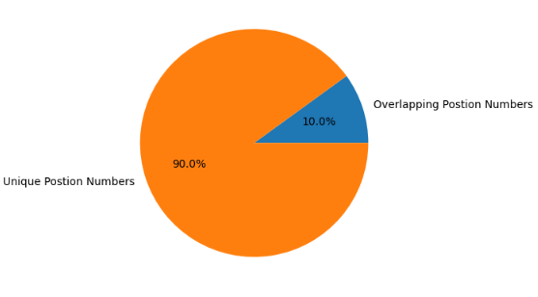
Process: EDA
Python Scripts for the EDA
Position Number Overlap
All of the positions in the applicant data have matching values in the employee dataset. The opposite is not true. So using this fact I explore the demographic distributions using the entire dataset and the subset which overlaps.

Slide 7
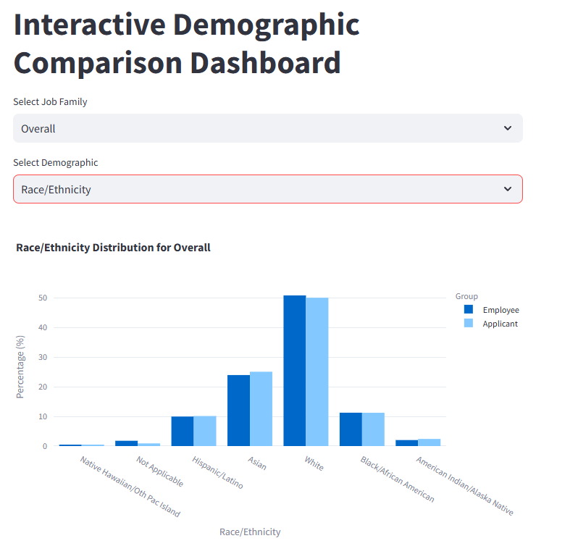
Process: Initial Findings Percent Distribution
Aggregate Data
The distribution of aggregated employee and applicant data were within unremarkable ranges of one another.
Job Family
Job Family is present on the employee data but not the applicant data. Having this level of deaggregation would allow for more in depth analysis.

Slide 8
Process: Initial Findings
Significant Differences Whole Dataset
Significant Differences Subset Dataset
Job Family Continued
Using the position number from both data sets I was able to recreate the job family column in the applicant data.
Percentage Differences
To simplify the list of demographic instances to explore a check looking for situations where the employee percentage of a demographic group is more than 7.5% different than the percentage of the applicant pool. These job families populate the “Attention Areas”.
Job Families: Athletics, Fine Arts & Entertainment, Healthcare, Human Resources, Library, Police & Safety

Slide 9
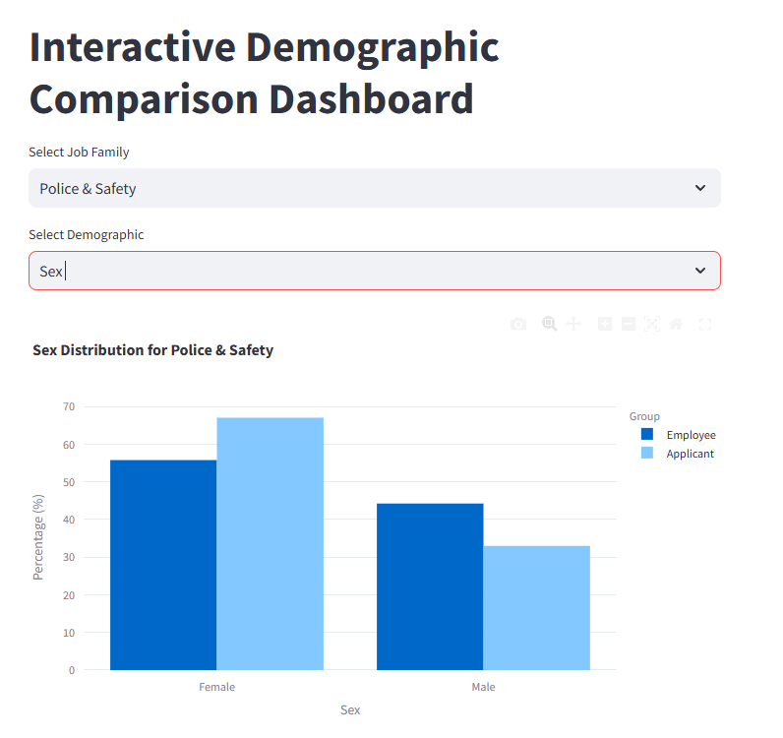
Attention Areas: Visuals
OCR Dashboard
An interactive set of charts from the data that can be viewed at the link to the left.

Slide 10
Next Steps: Admin Review
Attention Area Investigations
The graphs in the attention areas could have very reasonable context for their discrepancies between the employee pool and applicant pool. With that being said, exploring more deeply the context of these differences would be a top next priority.

Slide 11
Next steps: Data Analyst
Data Validation
Ensuring ID, and position numbers are validated. Looking for duplicates or IDs that do not follow standard syntax if applicable
Salary Investigations
There is salary data that was not explored with the initial analysis. This is a strong area for next efforts.

Slide 12
Next steps: Data Analyst
Explore Military Status Conflicts
There are a several enumerations in the military status column that appear in the employee data but not the applicant data.
Expand groupings to EEO-6 Categories
The process for job family grouping could be repeated using the EEO-6 designations.
Explore applicant status
The applicant status column could reveal useful context.

Slide 13
Long Term Goals
Automate Retrieval and Attention Metrics
Assuming this data is updated at regular intervals, creating a system to pull the information and track attention area metrics regularly could help with tracking updates to hiring policies.

Slide 14
Resources
Dashboard
Git repository

